Slide 1

Azure
Data, Artificial Intelligence, and Advanced Analytics
Steven Kirchoff, Account Executive
David Zarling, Azure Specialist
Michael Cruz, Data/A.I. Specialist
Julian Soh, Data/A.I. Engineer

Slide 2
Agenda
Introductions
Goal
Discuss
Challenges
Role of an I.T. Auditor
Share
Scenario-based discussion
Next steps

Slide 3


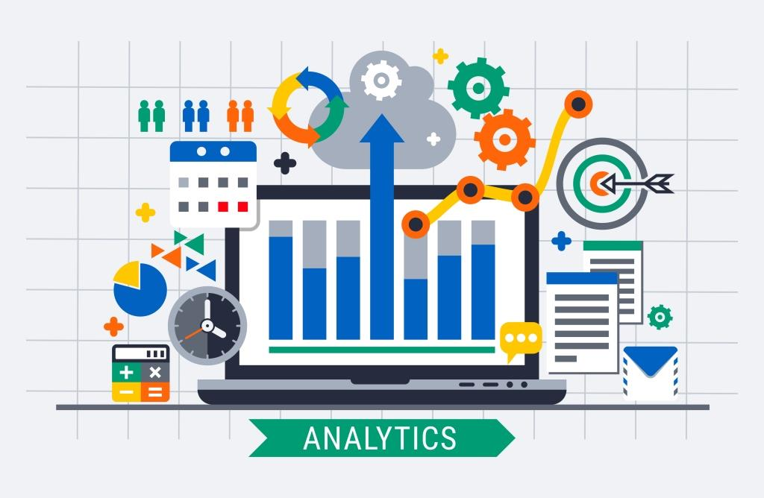
Characteristics of an Audit
People
Data
Technology

Slide 4
Characteristics of an audit - Data

Slide 5


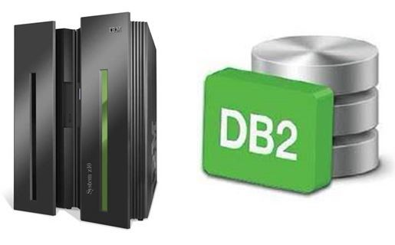


Traditional Data sources

Slide 6





Modern Data Sources

Slide 7


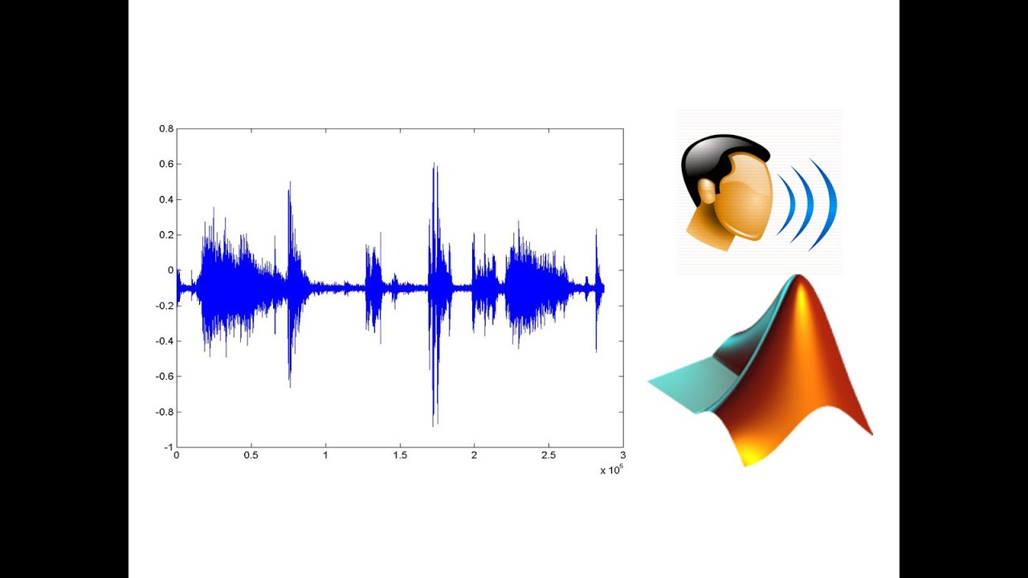
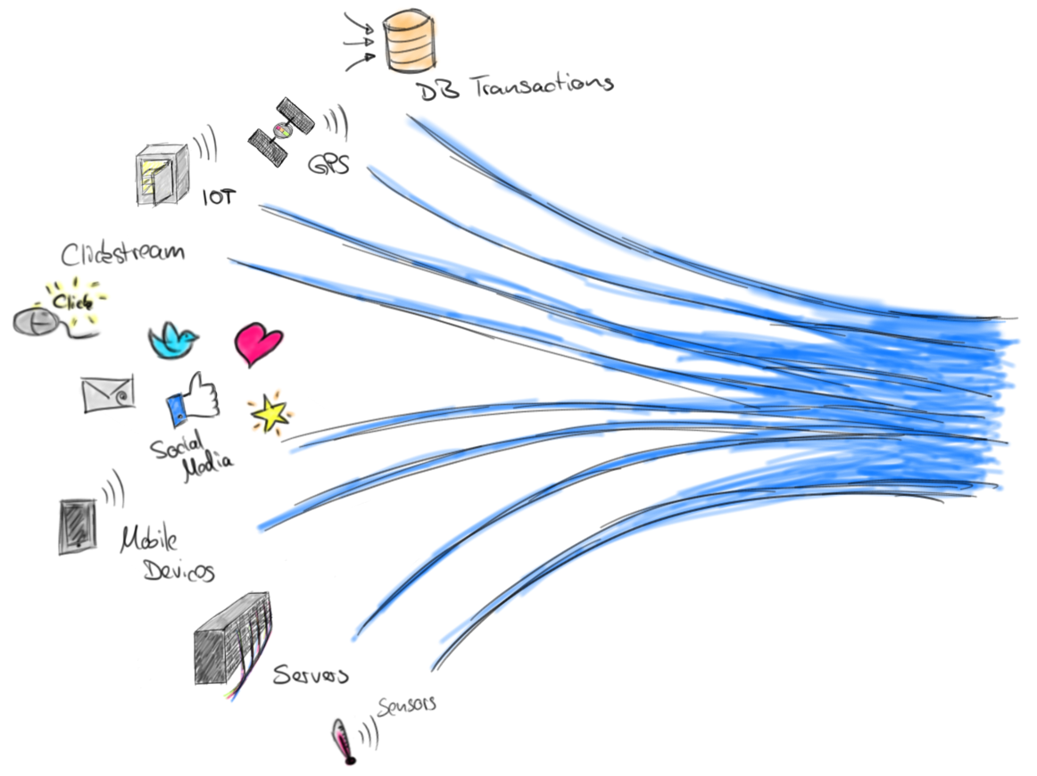
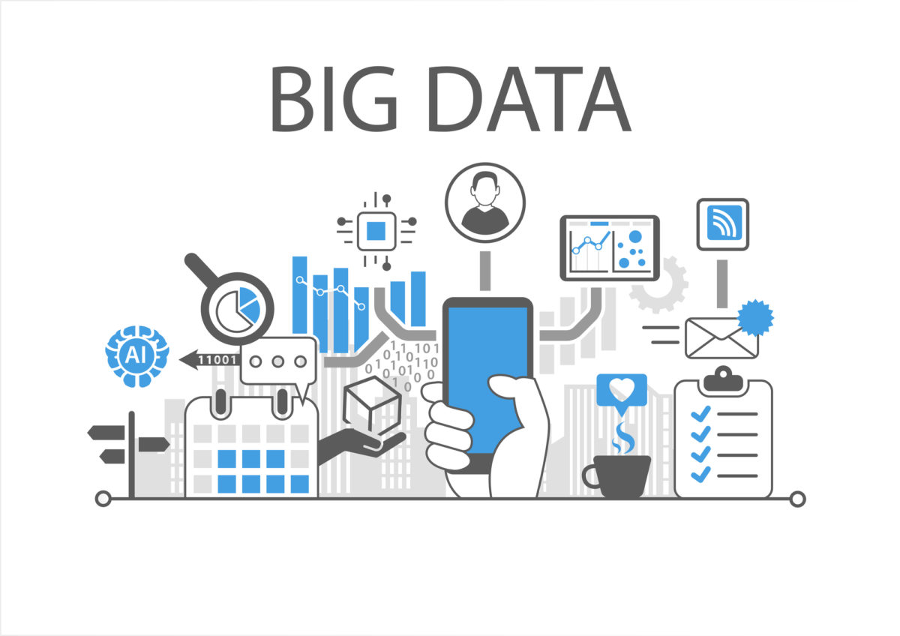
Emerging Data Types
Audio
Video
Diarisation and voice forensics
Streaming data

Slide 8
Characteristics of an audit – People
People
Collaboration
Experiments
Documentation
Version Control
Skillsets
Geography

Slide 9
Characteristics of an audit - Technology
Technology
Economically viable
Current
Scalable
Available (anytime, anywhere)
Secure
Agnostic or very close to agnostic

Slide 10
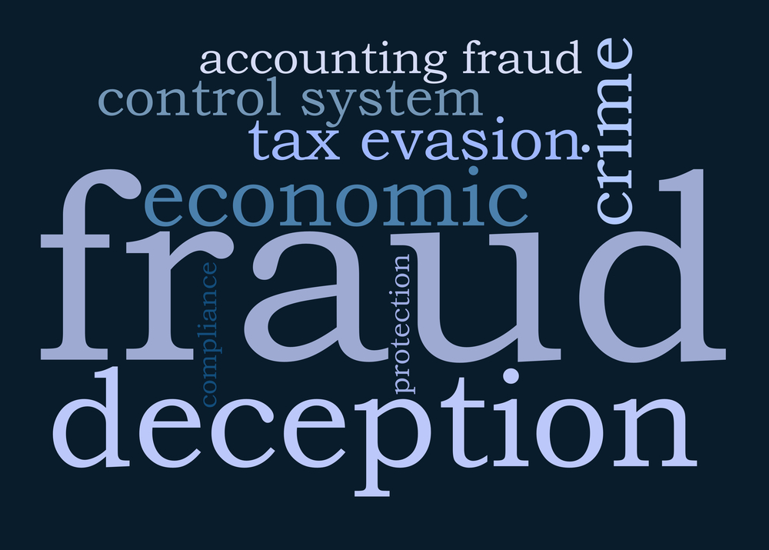
Scenario based discussion

Slide 11
Resources
Microsoft Learn
AZ-900: Azure Fundamentals
DP-200/DP201: Data Engineering and Data Architecture
AZ-400: Azure DevOps
AI-100: Introduction to Artificial Intelligence and Machine Learning
Cloud Skills Challenge Contest

Slide 12
References
Real-time fraud detection using CosmosDB to analyze streaming data
Anomaly Detection using Azure ML Studio
Real-time fraud detection on Azure (additional use cases)
Introduction to Azure Machine Learning

Slide 13
Challenges
Data, data, and more data
Data wrangling / sharing
Data engineering (DTL vs DLT)
New types of Data
Structured Data
Semi-Structured Data
Unstructured Data
Big Data
Ingestion time
Processing time
Analysis
Workforce diverse skillsets
T-SQL
Python
Scala
R

Slide 14
High-level view: Big Data project

